Slide 1
Warm up activity for parents! These are some of the sounds that Reception have learnt so far. How many 3 letter words can you make?
s | a | t | p | i
n | m | d | g | o
e | u | c | l | f

Slide 2
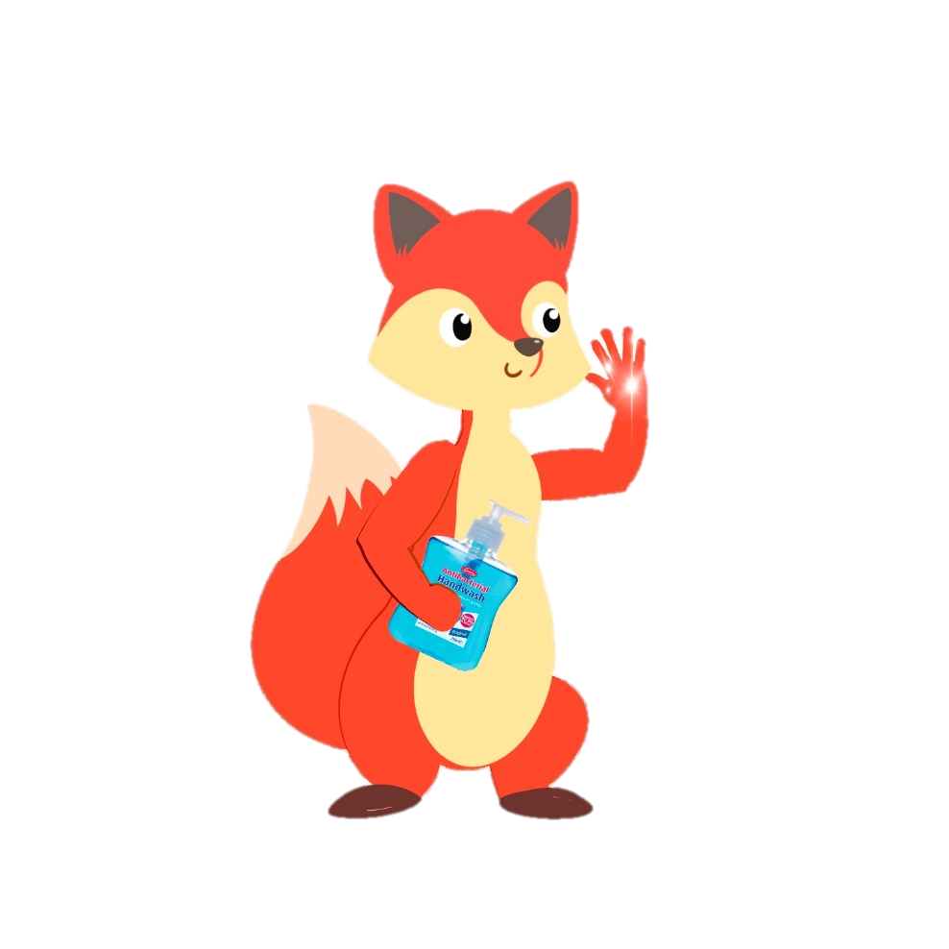
Reception Phonics Workshop
A big thank you for showing your support.

Slide 3
Little Wandle Letters & Sounds Revised
How do we teach phonics using Little Wandle?
Daily short lessons
Following the specified order of teaching
Constant review elements to each lesson recapping previously taught phonemes
Modelling of correct pronunciation

Slide 4
Key Vocabulary
Blending – Blend to read
Segmenting – Segment to spell
Digraph – Two letters that make one sound.
Trigraph – Three letters that make one sound.
Phoneme – The sound letters make.
Grapheme – The way the sound is written.

Slide 5
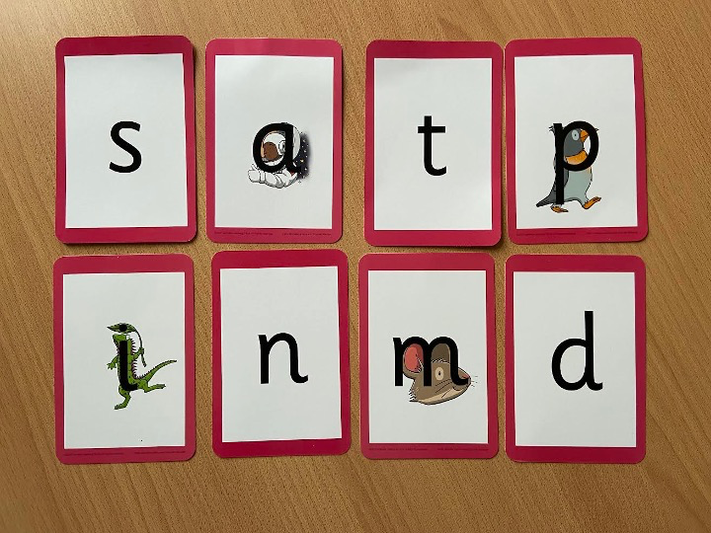
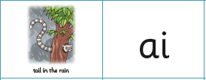
Little Wandle Letters & Sounds Revised
Each phoneme that we teach, has a
mnemonic to go alongside it…
s – snake a – astronaut t – tiger
When we introduce digraphs, they are
also taught with a catchphrase too…
ck – rock that sock ai – tail in the rain

Slide 7
Blending and Segmenting
Oral blending – no written pressure, no GPC knowledge needed
Once we have a secure knowledge of some GPC’s we can get to the best bit – blending and segmenting!
Blending – Pushing phonemes together
Segmenting – Breaking up the word into phonemes (spelling).
d
u
ck
e
bell
b
ll

Slide 8
Home Learning
Ideas for home learning:
Hear the initial sound in words.
Write different graphemes and say a sound to your child and they circle the correct sound.
Read and write 3 letter words. You could write 3 letter words for your child to read around the house.
man, cat, sun, top
Ask your child to write your shopping list. The children can have a go at writing the sounds they can hear in sequence.

Slide 9
Using sound buttons
map sheep
Tricky words are taught differently as they cannot be read, or spelt, using our phonic knowledge. We always teach the child what part of the word makes it tricky.
the

Slide 10
Phonics Screening
Phonics in the Early Learning Goals
ELG: Word Reading
Children at the expected level of development will:
Say a sound for each letter in the alphabet and at least 10 digraphs;
Read words consistent with their phonic knowledge by sound-blending;
Read aloud simple sentences and books that are consistent with their phonic knowledge, including some common exception words.
ELG: Writing
Children at the expected level of development will:
Write recognisable letters, most of which are correctly formed;
Spell words by identifying sounds in them and representing the sounds with a letter or letters;
Write simple phrases and sentences that can be read by others.
All children have to take the Phonics Screening Check in Year 1.
They have to read 40 words.
The words are real and ‘alien’.
hock

Slide 11
Reading Practice
These take place in small groups, three times per week.
Books are chosen based on the child’s ability and link to graphemes they have already been taught
Session 1 – Decode
Children begin to decode the words and have opportunities to read as a group and independently.
Session 2 – Prosody
This refers to the expression and tone of voice when reading. Children explore their text and look at key features such as exclamation marks. They practise reading parts of the text with expression.
Session 3 – Comprehension
In this session the children answer questions based on the book they are reading. For example, they may be asked how a character is feeling or what is happening.

Slide 12
Reading Practice
Our target is to be reading yellow books by the end of the Reception year, and that the children can demonstrate the ability to independently read sentences to achieve the Early Learning Goal.
Before the children move up to the next book band, they need to be fluent and confident when reading books in their current book band. Re-reading books at home will promote this so don’t feel like you can’t read the same book 3 or 4 times. Fluency is key!
Lilac | Pink A | Pink B | Red | Yellow

Slide 13
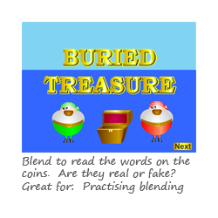
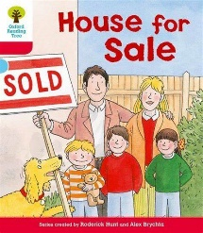
How you can help at home
Reading Every Day - RED
Phonics Play
Oral blending games
Sound spotting in your local area
Any opportunities for children to write or read daily
Explore the parent page on the Little Wandle website
Reading Every Day

Slide 14
Our favourite app!
This app has now been approved by the Department for Education.
It is a fun, educational game that the children will LOVE!

