Slide 1
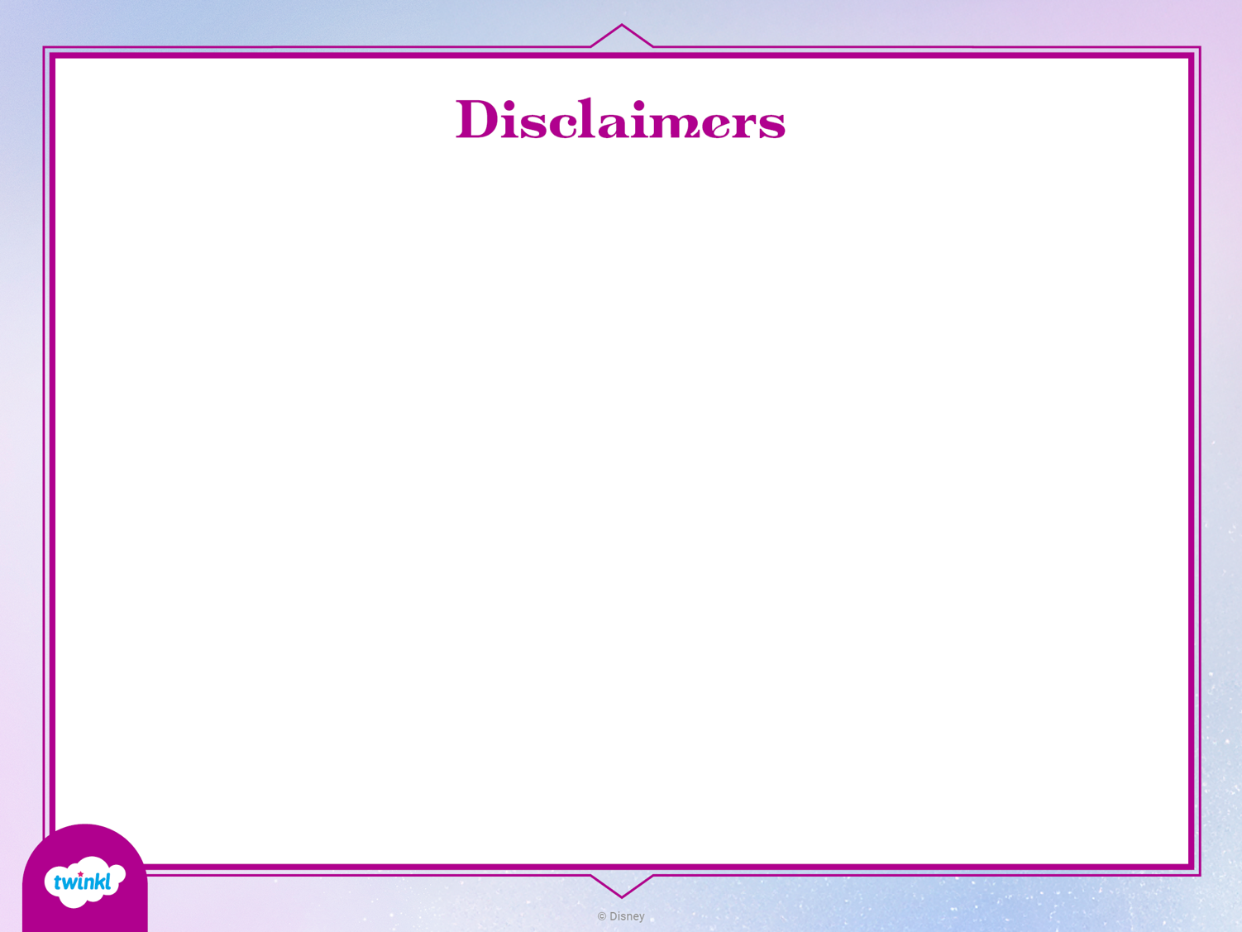
Editable Resource
This resource is editable. Twinkl cannot be held responsible for any changes made once a resource has been downloaded. Please be aware that this content may have been edited and therefore may no longer reflect our values.

Slide 2


Slide 3
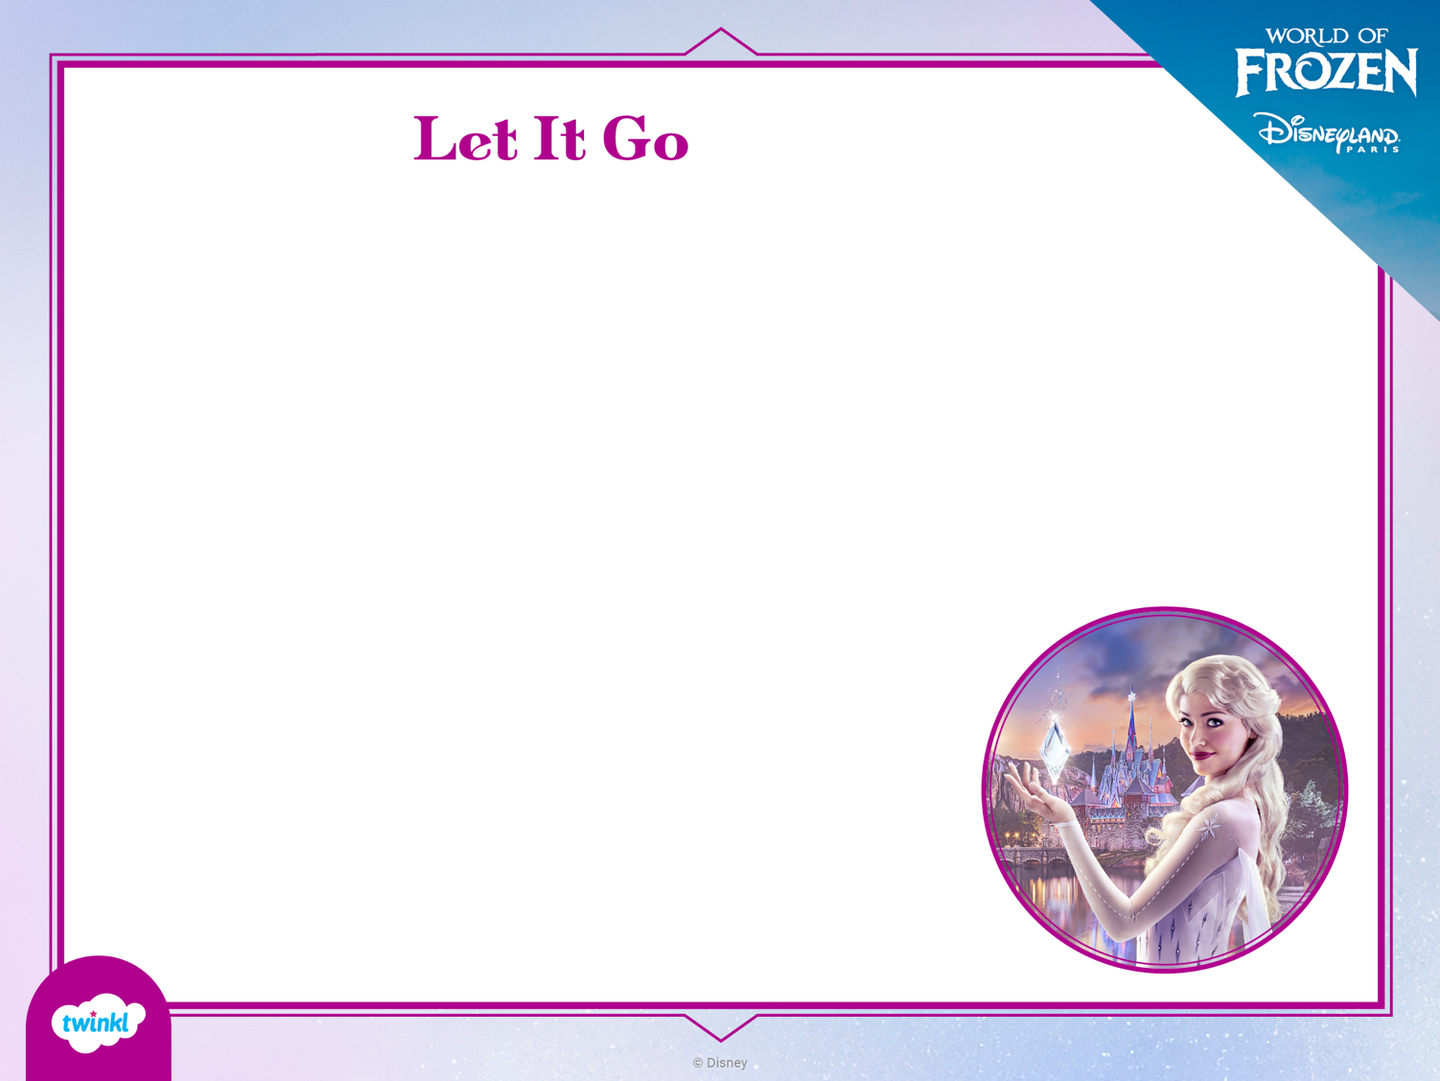
Let it go, let it go
Can’t hold it back anymore
Let it go, let it go
Turn away and slam the door
I don’t care what they’re going to say
Let the storm rage on
The cold never bothered me anyway.
Let It Go
Written by Kristen Anderson-Lopez and Robert Lopez
Published by Wonderland Music Company, Inc. (BMI) All Rights Reserved.

Slide 4
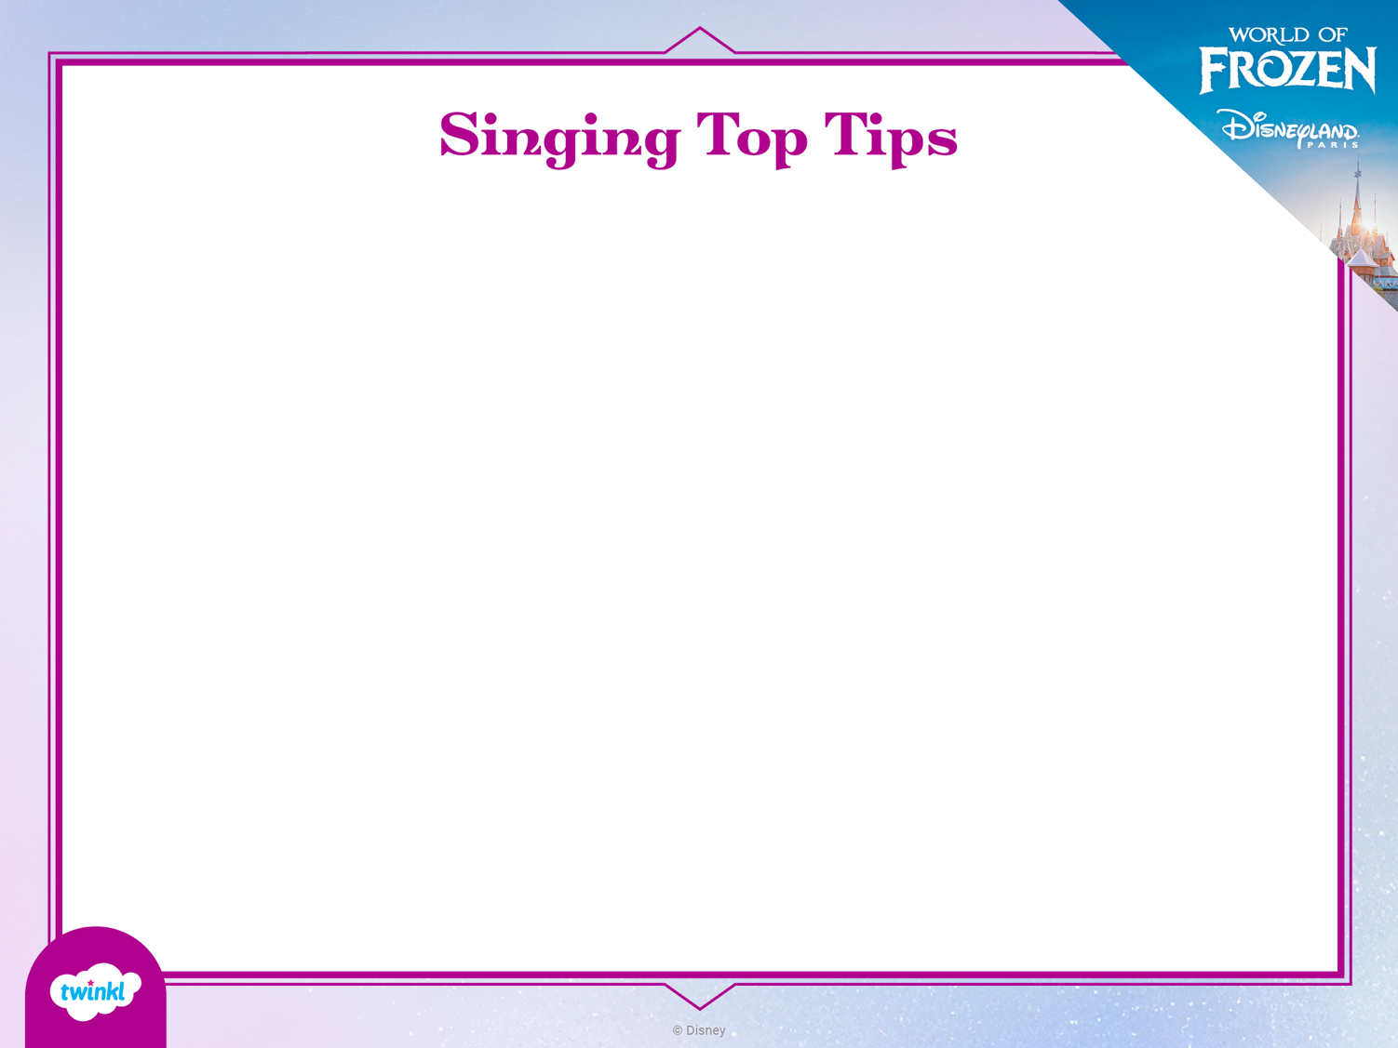
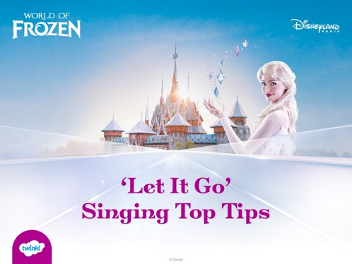
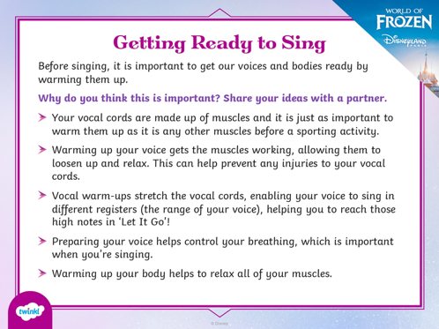
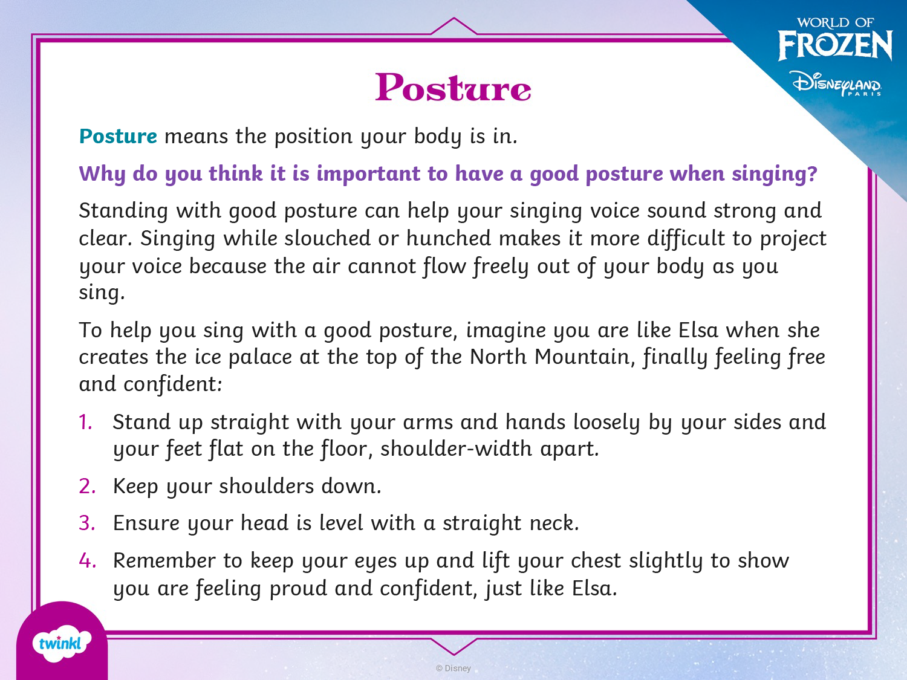
Why not try some of the suggestions in the Singing Top Tips PowerPoint and see how they improve your performance?

Slide 5
