Slide 1
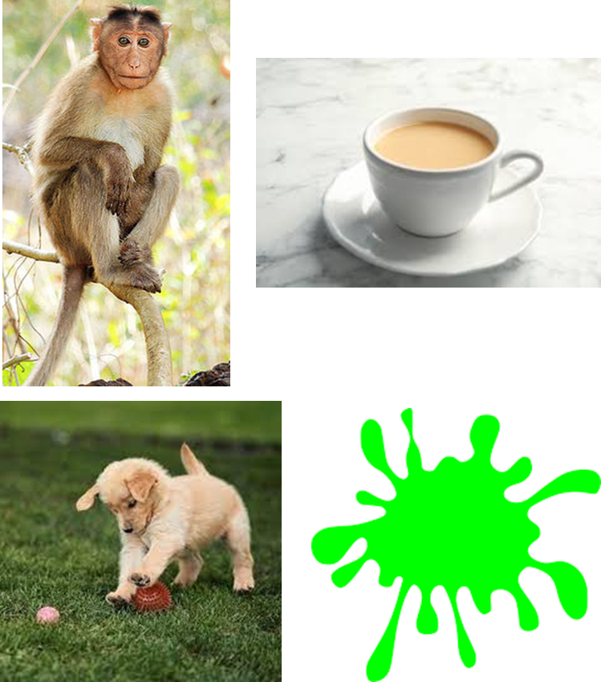
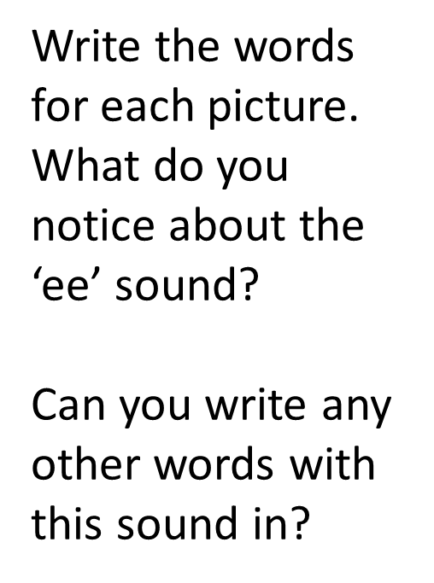
Welcome
Warm up activity

Slide 2
Warm up activity
monkey
tea
puppy
green
By the end of Year 1, the children are taught 7 ways to write the /ee/ sound!

Slide 3
Welcome to our Year 1 Phonics Workshop

Slide 5
Phases
By the end of Year One, the children will have learnt 8 different ways to write the /ai/ sound!

Slide 7
Blending and Segmenting
Blending - Pushing words back together
Segmenting – Breaking up the word into sounds to spell.
s
n
ai
l
r
ai
n
rain

Slide 8
Key Vocabulary
Blending – blend to read
Segmenting – segment to spell
Digraph – Two letters that make one sound.
Trigraph – Three letters that make one sound.
Phoneme – the sound letters make.
Grapheme – the way the sound it written.

Slide 9
Which part makes the following words tricky?
house what should

Slide 10
Phonics Screening
All children have to take the Phonics Screening Check in Year 1.
They have to read 40 words.
The words are real and ‘alien’.
There is no time limit.
They will complete the check with their class teacher.
Children must blend the words back together.

Slide 11
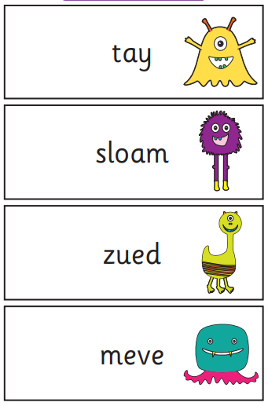
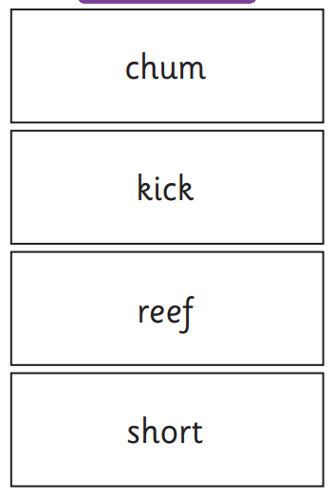
Phonics Screening
The test contains words from phase 2 to phase 5.
The pass mark is 32 out of 40 (usually!).

Slide 12
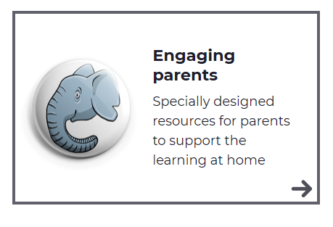
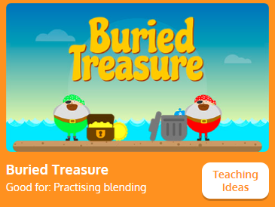
How you can help at home
Reading Every Day
Any opportunities for children to write or read daily.
Little Wandle website

